Slide 1

yelpflix
1
Your Automatic, Customized Restaurant Recommendation
Nikki Lee | Scott Marler | Lisa Minas
1 Yelp.com logo
Notes:
Nikki

Slide 2
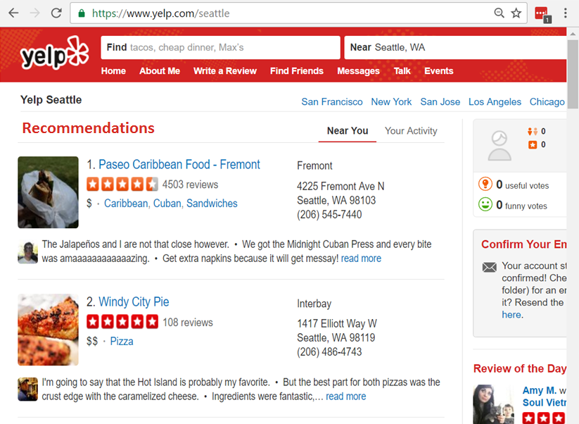


Goal
How do we make it easier for users to find a place to eat?
Provide automatic, Netflix-style recommendations on the home page
Notes:
Lisa
User Story
User logs onto Yelp to find a place to go eat
They’re in a new area and don’t know where to eat
They’re looking for a new restaurant to visit
They’re organizing a group and need to find a restaurant that accommodates a diverse range of diets
User types in location, type of restaurant they want, and then hunt through reviews to find recommendations
Time consuming
Relies on finding the ‘right’ set of keywords to search for
Eg: Searching for a place to get a frozen dessert -- Ice Cream won’t return Frozen Yogurt shops and vice versa though the restaurant type would satisfy the search intent
Project: Create a ‘Netflix’ like restaurant recommendation for users
Identify new restaurants for the user
Simplifies the search process by putting the recommendations up first
Will highlight relevant restaurants quickly without hunting for the ‘right’ keywords
Makes Yelp a valued tool in exploring a location versus a full process
Process: Criterion of recommendations
Their current location
Their home location
Their prior ratings of similar restaurants
Ratings from similar users
A similar user is someone who has given similar reviews for the same restaurant

Slide 3
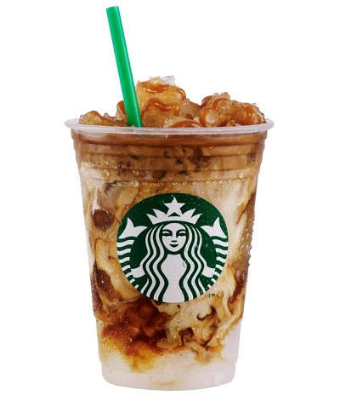

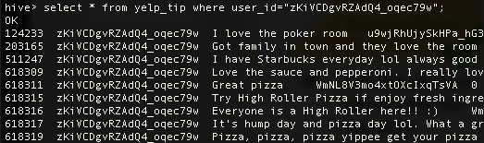
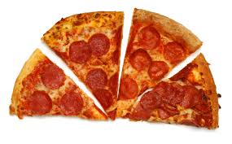
Milestones Achieved
Data Acquisition
Data Organization
Data Analysis
Initialize git repo clones onto our instances
Load initial dataset available on Yelp onto HDFS
Create tables according ER diagram to store business and user data
Schema-on-read databases from json files provided by yelp

Slide 4
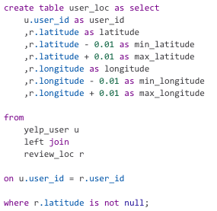

Next Steps
Data Acquisition
Data Organization
Data Analysis
Simulate user locations
Determine user preferences
Based on number of tips
Highest rated type of restaurant
Most reviewed type of restaurant
Find similar users for recommendations
Create final output with recommendations

